Slide 1
NOISE and SHARPENING
Diederik and Tony

Slide 2
OUTLINE OF TALK
1. What is noise – Diederik
2. What is sharpening – Diederik
3. Noise and sharpening in Lightroom – Diederik
4. Sharpening for creative effect in Photoshop – Tony
5. Sharpening for output - Tony

Slide 3
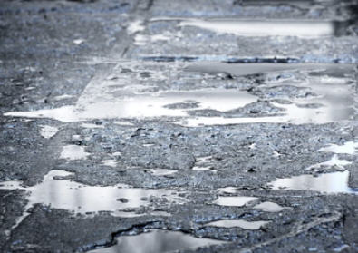
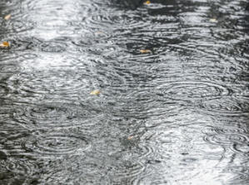
RAINFALL OVER TIME
Over a short time
Over a longer time
Notes:
Consider the first few seconds after it starts raining. We get a random splatter pattern on the pavement then after some further time has passed the pavement is completely wet.
This happens because rain falls as lots of individual drops of different but similar sizes.
The drops don’t all fall at the same time like water from a tap and it takes a certain amount of time before we can estimate the intensity of the rain.
If the rainfall is heavy it takes less time.

Slide 4
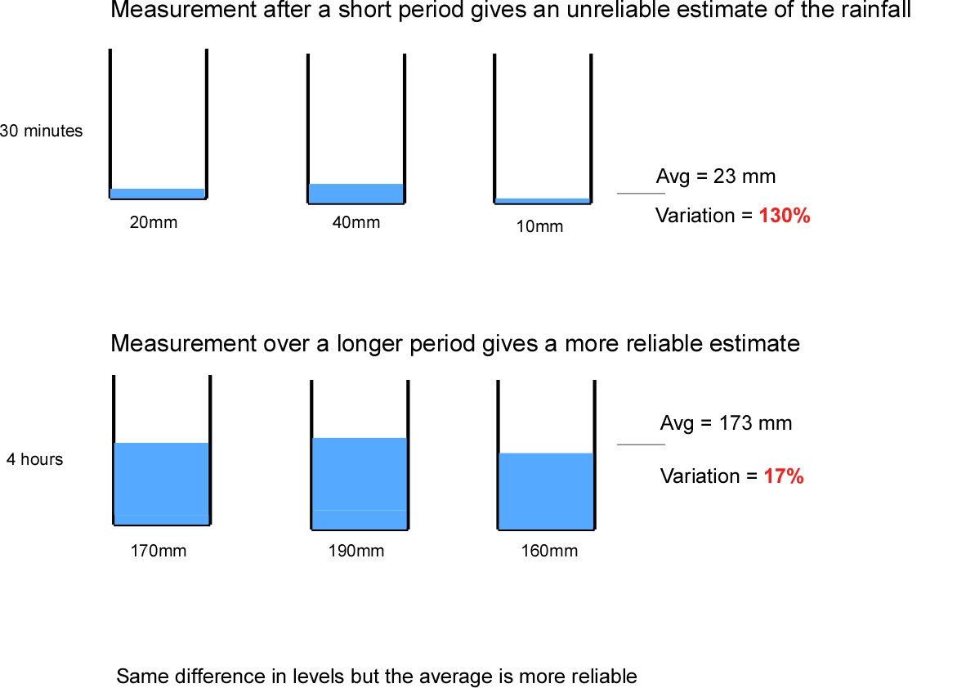
Notes:
If we collect the rain in several adjacent buckets there will initially be a great variation in percentage terms between the contents of the buckets – one might have 50% more than its neighbour.
After a few minutes, when the buckets are fuller, this variation becomes relatively much smaller, say 10% between buckets, because the randomness of rain drop arrivals has been averaged out over time.

Slide 5
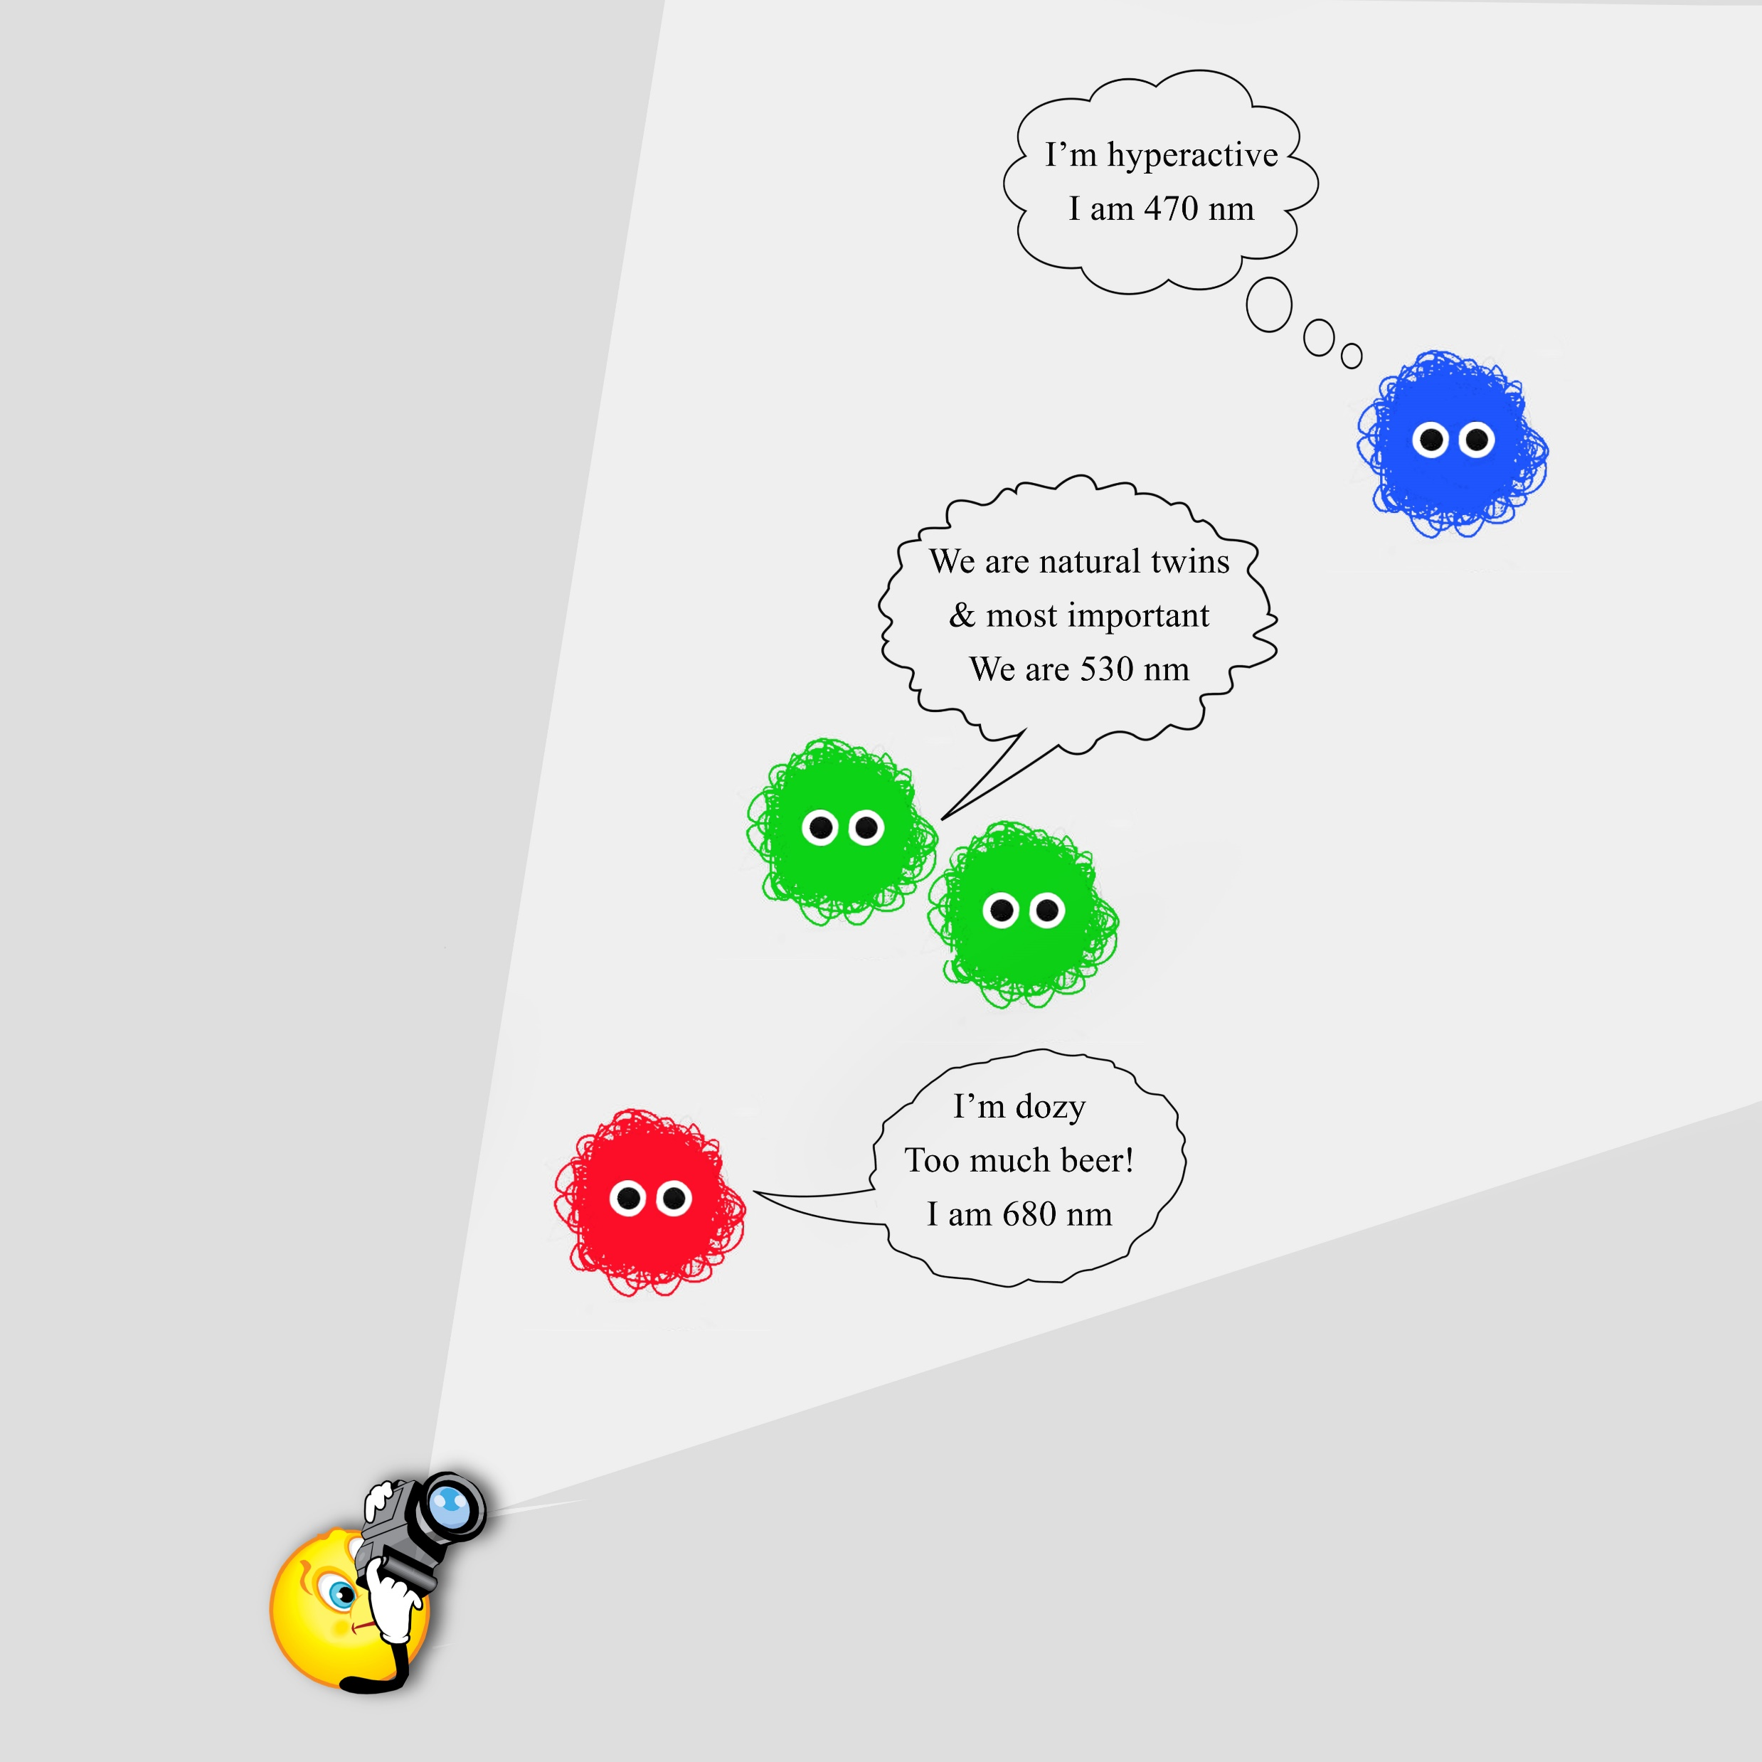
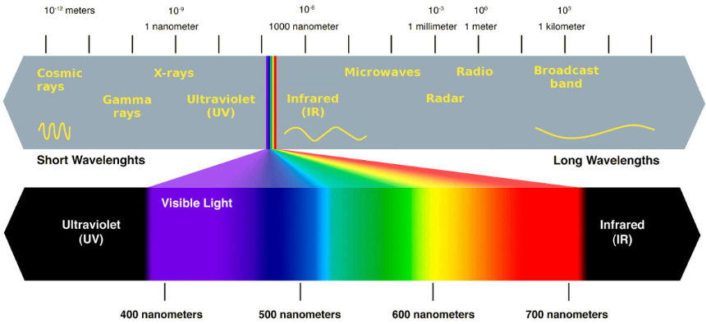
Electromagnetic Spectrum
Notes:
Visible light is similarly composed of tiny energy parcels called photons.
The energy of these photons varies and we equate this variation with a property called wavelength.
Photons with smaller (shorter) wavelengths have more energy than those with greater (longer) wavelengths.
Our brain interprets these wavelengths as colour with shorter wavelengths perceived as blue-violet and the longer wavelengths as red.
We can equate the energy of a photon with the size of a raindrop.

Slide 6
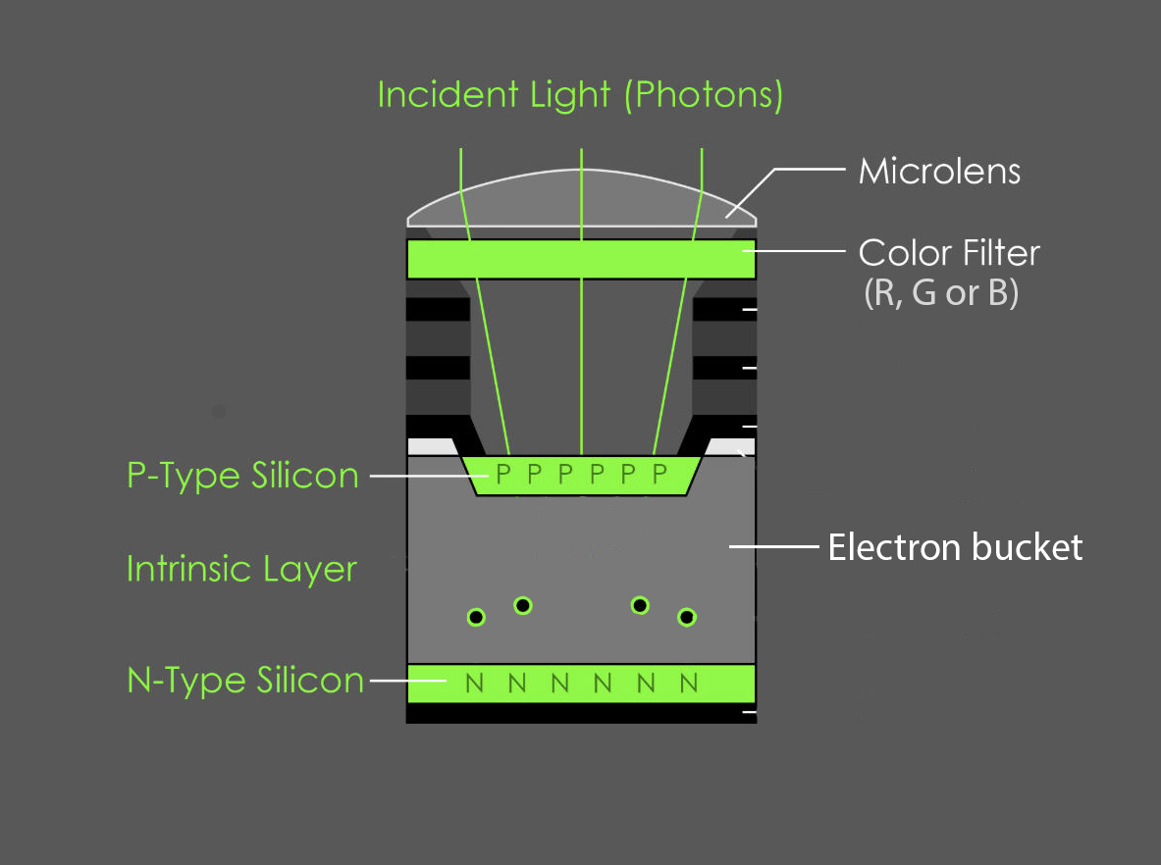
Typical Photosite (Pixel)
Notes:
Photosites (pixels) on an image sensor act like buckets.
They detect incoming photons, convert them to charged particles called electrons and store these in an electron bucket (capacitor) for a period of time (the shutter speed).
After the shutter closes, other circuitry reads the charge, converts the charge to a number and empties the bucket.

Slide 7
Light hitting a single 4.0 um pixel in 1/60th second exposure:
Lighting | No of photons
Starlight | 0.1
Living room | 50,000
Overcast outside | 1,000,000
Full sun | 100,000,000
A pixel in a modern sensor might only handle about 50,000 photons before saturation, that is, filling up or blowing out.
About two thirds of the incoming light is wasted.
Notes:
A photosite on a modern sensor will typically have a capacity to hold about 50,000 electrons before it fills up.
A lot of the incoming light (photons) is wasted this might be equal to 150,000 photons hitting the sensor area.

Slide 8
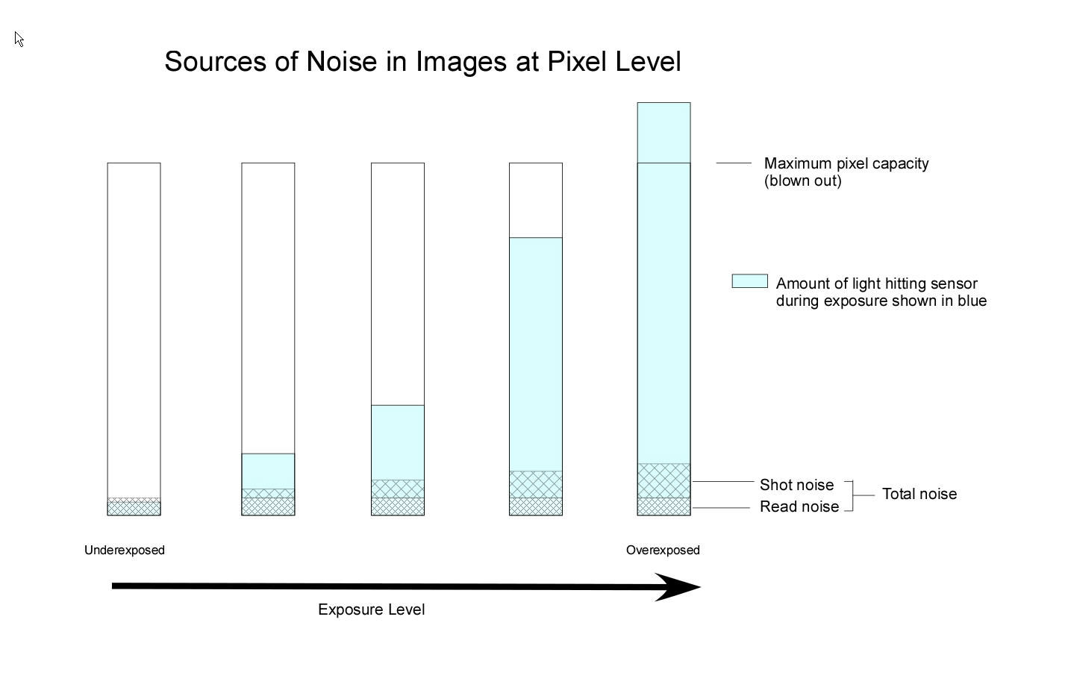
Notes:
Like rain, when the light detection is over a very short period or the light intensity is low we get a lot of variation between pixels.
This is called shot noise.
As we collect more light (photons) this becomes a lesser component of the total photons collected by individual pixels and we can measure the light intensity more accurately, but it is always still present.
It increases at a lesser rate than the recorded light signal (actually the square root) so the more light that we collect the better u to the point of saturation.
However, there is another source of noise called read noise which results from the inefficiency of the sensor circuitry.
It remains at a constant level even when there is no incoming light so it limits the ability of the sensor to accurately record low levels of light thus affecting the dynamic range.
Those doing long exposures at night with very low light levels are always fighting read noise which dominates at low light levels.

Slide 9
Luminosity Noise
Notes:
If we haven’t collected enough light due to a fast shutter speed and/or the light level being very low then two adjacent pixels measuring the same part of a scene are likely to register different light values.
We will see this as luminosity noise or dappling in the image.
When you increase the ISO on your camera this is just amplifying the signal which includes the noise so although the image becomes more visible so does the noise.
If you increase ISO too far not only do you get blowouts but there is a significant loss of dynamic range.
It is nearly always best to shoot as close to the base ISO of the sensor to get the best dynamic range.

Slide 10
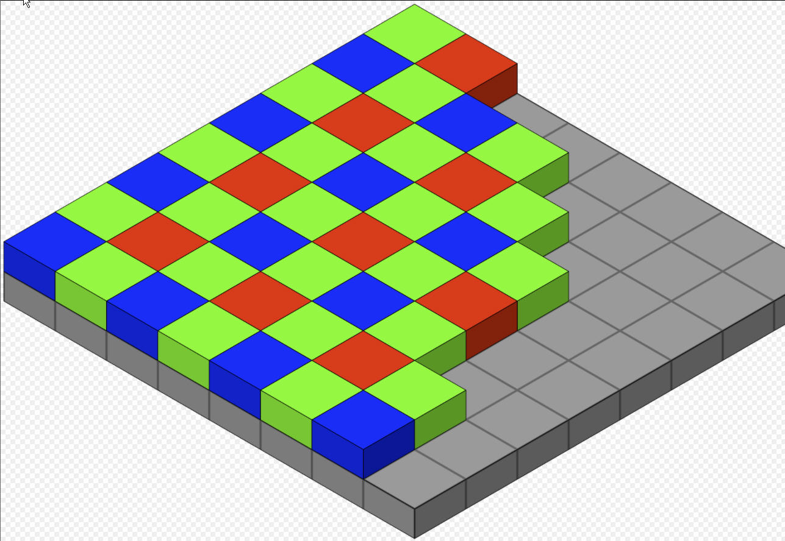
Bayer Colour Filter Array
Notes:
The noise situation is further complicated because camera sensors use different colour filters (RGB) on each pixel to separate out the photons of different energy levels thereby creating information that is compatible with our human vision.
So, a raw image file just contains a lot of numbers representing how much light was collected at each pixel and what type of micro lens (R G or B) was above that pixel.
There are twice as many green sites as red or blue because the eye is more sensitive to green.
The most common colour filter array is Bayer as shown but there are others such as on Fuji X series cameras.
Sigma foveon sensors capture all colours in the one pixel.

Slide 11
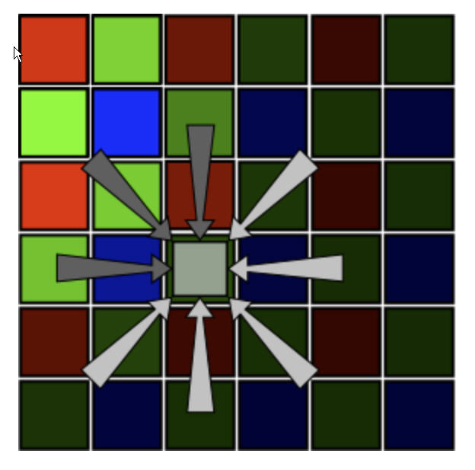
Demosaicing – VNR Method
The change (gradient) in RGB values around each pixel is calculated in 8 directions.
The biggest changes are rejected and a new pixel value is calculated by averaging the remainder. This helps preserve edges.
Notes:
A raw image file like this is useless for viewing so the data is processed either by the camera (to produce a jpeg file) or by software such as Lightroom or Adobe Camera Raw to produce RGB values for each pixel.
This process is called demosaicing and is basically an averaging of nearby pixel values to determine likely RGB values for each individual pixel.
Demosaicing algorithms can be quite simple where a pixel value is just averaged from the surrounding pixel RGB values.
They can also be quite complex but the complexity is often limited due to the need to do it a speed, especially in the camera itself.
One of the desirable objectives in such an algorithm is the preservation of edges in the output image.
Different types of images can benefit from different approaches but these are not always available in many products and in many cases edges suffer.
The current best demosaicing algorithm is probably AMAZE which is implemented in programs such as Darktable and Raw Therapee.
It is computationally intensive and as far as I am aware is not implemented in Adobe products.
It is worth noting that the Enhance process recently introduced to Photoshop to increase resolution is, in effect, another demosaicing algorithm using machine learning.
This is no doubt the way of the future.

Slide 12
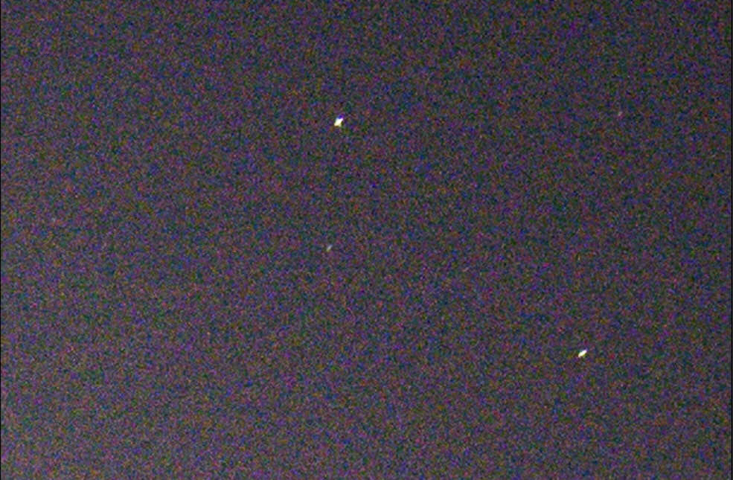
Colour (chromatic) Noise
Notes:
Of course, this process starts with a certain level of inherent noise and is, in any case, not perfect.
This gives rise to a progressive failure in the of the demosaicing algorithm in being able to determine the most appropriate RGB levels.
The outcome of this is colour or chromatic noise.
This Astro photo is a good example.
Demosaicing and noise reduction both tend to destroy the clarity of edges and so some remediation is often required by employing a sharpening process.

Slide 13
Three Stages of Sharpening
Capture sharpening of a raw image
Creative sharpening for artistic effect
Output sharpening for presentation
Notes:
Sharpening is a technique for enhancing the appearance of edges in an image by adding a synthetic local contrast.
It makes edges more pronounced.
More generally, sharpening that can be considered at three stages in image production:
Capture sharpening in a raw image;
Creative sharpening for artistic effect
Output sharpening for image presentation, especially printing.
I will explain the general concept and then talk about stage 1 (capture sharpening) in LR.
Tony will speak about stages 2 and 3 in PS.

Slide 14
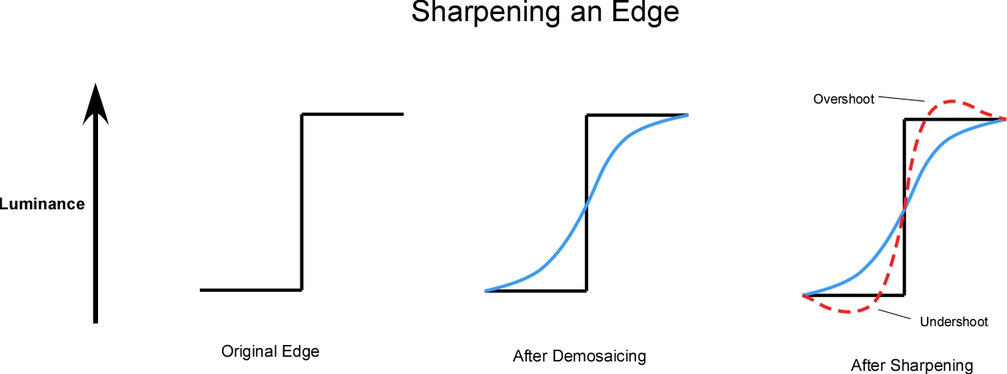
Notes:
In a raw demosaiced image, edges that were originally well defined are inevitably slightly blurred despite the efficacy of the algorithm.
Noise reduction also tends to blur edges.
Sharpening the image when first brought into Lightroom can improve its appearance.
The most common sharpening method is called Unsharp Mask and I will explain that here.
The term appears contradictory to the purpose but it has its origins in a darkroom technique involving the superimposition of a slightly blurred (unsharp) negative over an unblurred negative to achieve sharper edges.
The sharpening process detects edges in the image by analysing gradients then slightly increases brightness on the more luminous (brighter) side of the edge and slightly decreases brightness on the less luminous side of an edge to create a local high contrast.
This causes the eye to see the edge as being better defined.

Slide 15
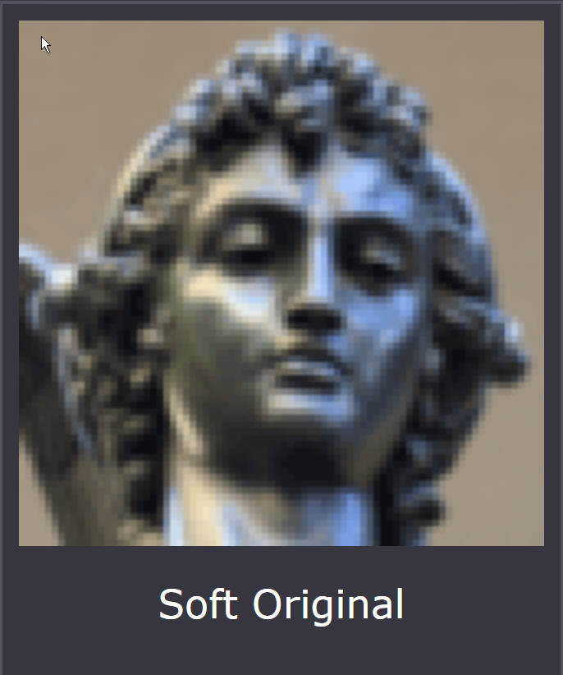
Effect of Sharpening on an Image
Notes:
The trick is to do this without it being obvious.
This series of shots are borrowed from website Cambridge in Colour and illustrate the point.
They are zoomed in to 200% for clarity.

Slide 16
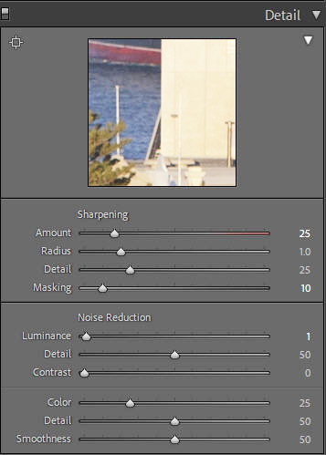
Sharpening Parameters in Lightroom
Notes:
In Lightroom global sharpening is controlled by four parameters called Amount, Radius, Detail and Masking.
Amount controls the amplitude of the local contrast, that is how much overshoot and undershoot are applied.
At default LR sets this to a value of 40 but it can vary up to 150 although I don’t know what these units actually mean.
Radius is specified in pixels and controls the size of edge features that are enhanced.
So, a small radius will tend to enhance edges on small details whereas a larger value will tend to ignore these and prefer larger features.
In Lightroom and ACR this is set between 0 and 3 pixels and the default is 1.0 pixels.
It can be meaningful to use values of less than 1.0 pixels.
Detail specifies how much emphasis is given to features of different sizes within the confines of the radius.
A high value will add extra local contrast to small features over that applied to large features.
I find that this parameter frequently has very little observable impact but it depends on the radius used as well as the image itself.
The Lightroom default is 25 on a scale of 0 to 100.
Masking is an essential tool in my view.
It sets a threshold for edges based on their existing contrast. As the parameter is raised lower contrast edges are ignored and the sharpening is applied only to higher contrast edges.
This may seem counter-productive but if you don’t use the masking tool you will emphasis lots of unimportant detail and even image noise.
The default setting in Lightroom is zero.
It takes some time and practice to fully appreciate how these parameters interact.
Sharpening needs to be applied gently to be effective. Over-sharpening can generate ugly halo effects and too little will not yield the desired effect.
The best way to use the sharpening tools is by holding the Alt key while moving the sliders.
This will temporarily desaturate the image allowing one to concentrate on the luminance effect being applied without the distraction of colour.
This is particularly true when using the masking slider.
Doing this will show the parts of the image that are selected for edge sharpening in white on a black background.
In general, for creative sharpening I will frequently have this set to quite high values to ensure I am emphasizing only the features that I want.

Slide 17
Using the Alt Key for Sharpening in Lightroom
Paste the link below into your browser for online video on this subject
https://youtu.be/hnVwfozMA_4
Notes:
To demonstrate how the Alt key can be used with the sharpening sliders, I’ve created a short video. The Alt key desaturates the image so that sharpening can be seen without the distraction of colour.
This is a snap of the Queen Mary 2 entering Fremantle Harbour in 2012 and is taken with a Canon 5D Mk ii.
For this demonstration I’ll zoom in to 200% so you can more clearly see the effects.
**************************************************************
Moving the Amount slider shows the immediate affect of varying the intensity of the sharpening.
Doing this while holding down the Alt key makes this even clearer.
***************************************************************
The Radius slider affects the width of the applied sharpening effect.
With too much sharpening and a large radius halo artifacts become quite ugly.
****************************************************************
To see the effect of the Details slider I will temporarily increase the radius to maximum.
This is because the Details slider is constrained within the radius.
At a radius of 1.0 pixels you will see very little effect.
****************************************************************
The masking slider is where it all comes together for creative sharpening in Lightroom.
With the Alt key held down, at zero the image is entirely white which means that sharpening is applied to the whole image.
As we move the slider to the right areas of black will appear.
Black indicates the areas where no sharpening will be applied , leaving only the features that you desire to be enhanced.
I will often have this slider at very high settings of 80 or more when applying creative sharpening but it depends on the image.

Slide 18
Capture Noise Reduction and Sharpening in Lightroom
For noise reduction at capture time my procedure is:
Make global tonal adjustments;
Zoom in to 100% or more;
Scan for areas of obvious noise;
Adjust the Colour slider first – the Detail and Smoothness sliders
can generally be ignored for the moment;
Adjust the Luminance slider while holding down the Alt key;
You can also use the Detail and Contrast sliders with the Alt key
but take care not to overuse or you will undo the noise reduction;
Sharpen to restore edges as required using the Amount and
Masking sliders keeping Radius at 1.0 and ignoring Detail;
8. Remove chromatic aberration.
Notes:
Noise reduction involves the averaging out of the luminosity and/or colour of adjacent pixels so by its nature there will be a slight blurring of the image and, in particular, of edges in the image.
So, sharpening to restore edges is a necessary adjunct to noise reduction when a raw file is imported.
When a jpeg image is created in-camera the manufacturer will nearly always apply some level of noise reduction and sharpening.
Depending on the camera you may have some control over the level of these processes.
However, when a raw image is imported into Lightroom you need to apply any noise reduction yourself.
The tools for doing this at a global level (whole picture) are in the Develop module in the Details panel.
Integral to this panel are sliders for Luminance noise reduction, Colour (Chromatic) noise reduction and Sharpening.
Of course, you might decide that you like whatever level of noise (grain) is in the image but it is generally worthwhile to examine this at an early stage.
The various sliders will be at default values as shown.
This seems to happen irrespective of whether the raw image comes from a Canon, Nikon, etc. and whatever profile is chosen.
My own procedure is to first make any basic tonal adjustments such as exposure, global contrast, white and black points, highlights and shadows but not any more localised effects such as texture, clarity and vibrance or any adjustments using masks.
I will then zoom in to 100% or higher and scan the image for areas where there is obvious noise that may affect the image quality.
You will most commonly see this in areas of continuous colour.
Looking at these areas I first adjust the Colour slider if required and then the Luminance slider to clean up any residual noise.
The Detail and Smoothness sliders under colour are supposed to set some sort of threshhold values for the application of the colour noise reduction but I’ve never been able to figure out how they do this.
I suggest leaving them alone in the first instance.
Nest clean up any residual noise with the Luminance slider.
If you hold down the Alt key while moving the Luminance slider it will desaturate the image and you can see the effect of this without the distraction of colour.
Likewise, holding down the Alt key allows you to see the effect of adjusting the Detail and Contrast sliders in mono.
These sliders also are meant to apply some sort of threshold to the noise reduction and they do have an effect but one needs to be careful not to undo the noise reduction in the process.
After any adjustment to noise reduction one should adjust the sharpening to restore the appearance of edges.
This tends to be a trial-and-error process.
The use of the Alt key to display monochrome with the sharpening sliders is invaluable.
I have previously explained the use of the Radius and Details sliders.
They will be of less use in capture sharpening than in more general creative sharpening.
On very high contrast edges such as a bird, tree branch or building taken against the shy, it is quite common to get chromatic aberration.
This appears are as purple or green edge fringing.
Fortunately, these fringes can be simply removed by toggling on the “Remove Chromatic Aberration” button in the Lens Correction Panel.

Slide 19
Live Demonstration of Global Noise Reduction and Sharpening
Andrew Winton performing at Perth Blues Club
Fuji GFX and 100-200 zoom
ISO 2500, 1/160th, F5.6
Underexposed to control blowouts and flare due to stage lights
Notes:
This is a snap of Andrew Winton performing at the Perth Blues Club (Image DSGF5801)
ISO 2500, 1/160 sec and F5.6
To control blowouts and flare due to unpredictable stage lights I normally underexpose these shots.
More commonly I use a lens at f2 or f2.8 but on this occasion the zoom lens I was using only goes to f5.6.
So, there is a bit of noise and I’ll demonstrate how it can be handled.
First adjust tonality: Exposure +1.8 Whites +30 Highlights -60 WB 5500
Crop to taste
Zoom in to 100% around face and microphone
No obvious colour noise so move on to luminance: Luminance 42 Detail 100 Contrast 75
Move on to sharpening – I’m mainly concerned with the area that is the main subject – I don’t want to sharpen noise and very fine detail.
Sharpening 80 Radius 1.5 Detail 27 Masking 80
Note that if converting an image to B/W it’s best to do this prior to global noise reduction and sharpening.

Slide 20
Selective Noise Reduction and Sharpening in Lightroom
To help isolate a subject from the background:
Use capture adjustment with reference to the subject of the image only;
Mask the entire image using the adjustment brush;
Erase the subject from the mask with another adjustment brush;
Adjust the area remaining under the mask.
To change apparent DOF in a landscape foreground:
Use the gradient tool to mask the foreground;
Adjust sharpness, clarity and texture to create the effect.
As with all such adjustments be careful not to overdo the effect. More is less.
Notes:
I was not going to spend much time on this area because Tony was going to cover it in Photoshop where there are many more tools available.
However, as Tony can’t be here tonight I’ll expand on this a little.
Very often one requires a different level of noise reduction and sharpening on the background than on the subject where you wish to preserve more detail.
Lightroom has masking tools (gradient, radial and brush) with a separate set of sliders that be used to achieve this.
The relevant mask adjustment panel only appears when a mask is active.
In this case we will just use the adjustment brush.
Make global adjustments to noise and sharpening as normal but looking only at the subject and ignoring the background until you are happy with the appearance of the subject.
Click the ‘Show Selected Mask Overlap’ button below the image.
Mask out the entire image with a large brush and maxed out Flow and Density sliders but zero Feather.
With a smaller brush change the action to ‘Erase’ and brush out the part of the mask over the subject.
Switch off the “Show selected Mask Overlay’ button.
Increase the noise reduction in the mask adjustment panel to achieve the desired level of smoothness.
You can also decrease sharpening with the adjacent sharpness slider and/or the Clarity.
This is working in the negative but, of course, you can also adjust noise reduction and sharpening directly within any masked area in the same way.
For example you may wish to adjust noise or sharpening in the foreground of a landscape image using a gradient mask to give the illusion of a greater or lesser depth of field.
As with all such adjustments be careful not to overdo the effect. More is less.
One can get nasty looking artifacts including haloes and worms by oversharpening and very plasticy looking images by overly enthusiastic noise reduction.

Slide 21
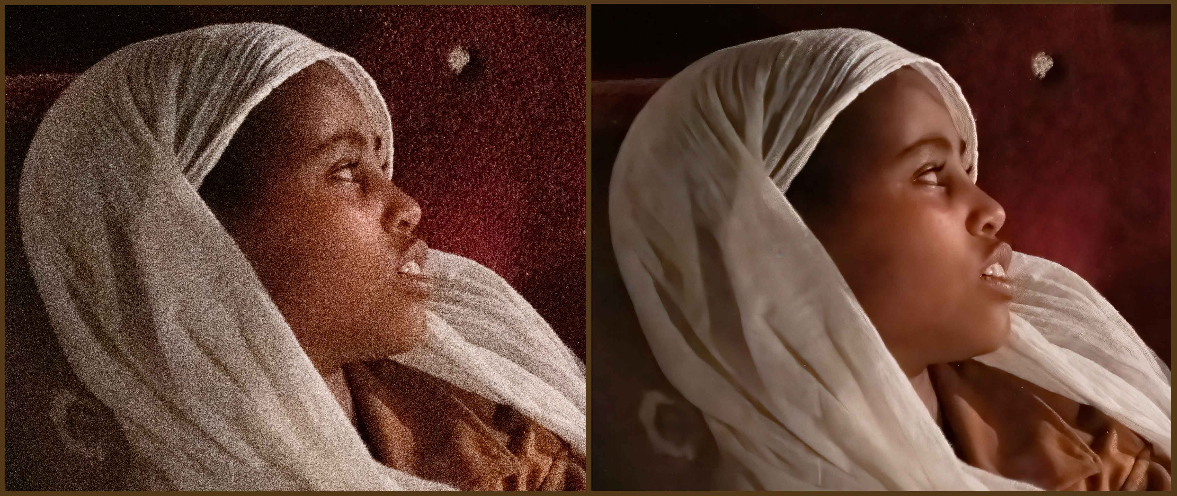
OTHER NOISE REDUCTION PROCEDURES
Noise reduction associated with Lightroom masking tools.
More sophisticated tools available in C1, Noise Ninja, Darktable and Raw Therapee.
Topaz Denoise AI can sometimes do a great job but original version was inconsistent.
Notes:
While Adobe does a reasonable job at noise reduction, there are some other more sophisticated tools available in programs such as Capture One, Raw Therapee, Noise Ninja and Darktable.
These may be worth exploring when one wishes to deal with noise in badly exposed images.
Topaz Denoise AI using machine learning techniques for noise reduction.
This is computationally intensive but can be operated as an add-in to Lightroom and Photoshop.
My own experience is that Topaz can do a great job but one needs to be cautious as results can be inconsistent.
In the image shown of a young woman in Ethiopia, the original lighting was very lowand I had to use an ISO of 8000 at F4 and 1/60th.
However. I managed to rescue the image at the cost of some detail in the fabric texture using Topaz Denoise AI.
I believe that masking for selective noise reduction is available in the latest version and this could have been beneficial in this image.

Slide 22
That’s all from me folks.
Over to Tony….

